Slide 1

AI Based Laptop Recommendation Software
Md. Hasibur Rahman
ID: 19101009
Tanmoy Mazumder
ID: 19101013
Shawan Das
ID: 19101020

Slide 2
TABLE OF CONTENTS
01
Project Proposal
02
CEP and Mapping
03
Requirement Analysis
04
Methodology
Introduction,
Problem Statement,
Objectives,
Literature Review
POs, COs, Ks, As
Time, Budget, Software and Harware Requirment
Waterfall Modell

Slide 3




01
Project Proposal

Slide 4

INTRODUCTION
Our goal is to create a web-based Laptop recommendation system using suitable NLP models of machine learning

Slide 5


Problem Statement
Recent Situation
The Problem
Proposed Solution
The pandemic and it's lockdown has made having personal computers a necessity
Regular Users are mostly unable to choose the perfect device for their needs.
Lack of Understanding
Too many options
Too many reviews
ML based recommendation system by analyzing text reviews from real users on web platform.

Slide 6
Objectives
Building a system capable of understanding human written reviews
Mapping user requirement to the suitable products based on the reviews and specifications
Providing a narrowed down list of suggestion

Slide 7
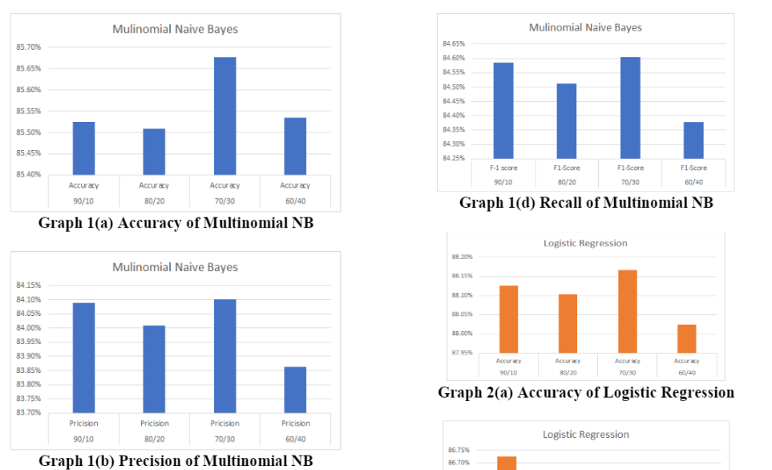
Literature Review
A. Product Recommendation using Sentiment Analysis of Reviews: A Random Forest Approach
Tries multiple approaches
Based on various products
Classifies the content based on polarity
Authors : Gayatri Khanvilkar, Prof. Deepali Vora

Slide 8
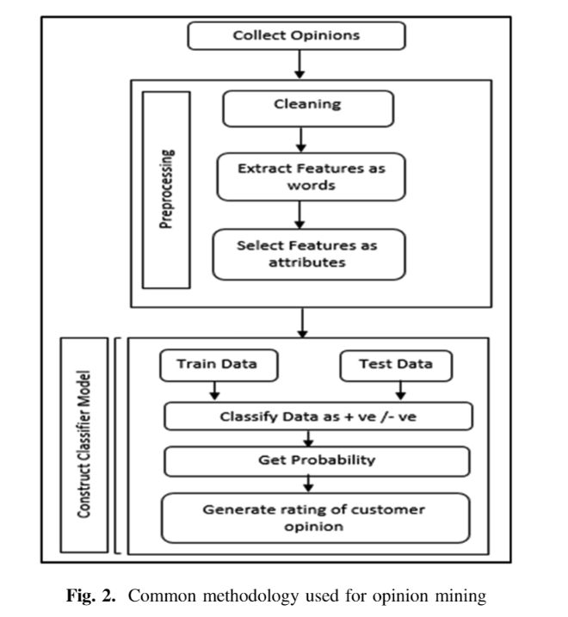
Literature Review
B. Data Analysis: Opinion Mining and Sentiment Analysis of Opinionated Unstructured Data
Provides a more structurally defined approach
Goes deeper into the topic of sentiment analysis
Discusses both approach of Machine learning and
lexicon-based
Authors : Harshi Garg ,Niranjan Lal

Slide 9
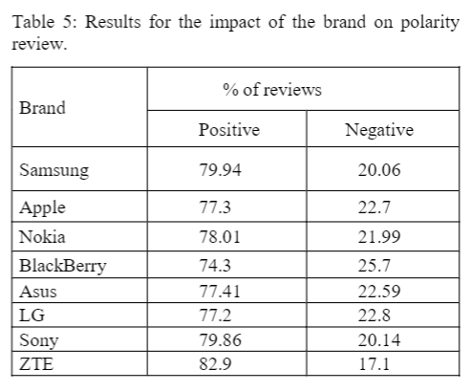
Literature Review
C. Comparison of Naïve Bayes, Support Vector Machine, Decision Trees and Random Forest on Sentiment Analysis
Works on a similar dataset: mobile phones
Little outdated
Viable with adjustments
Authors : Márcio Guia, Rodrigo Rocha Silva, Jorge Bernardino

Slide 10
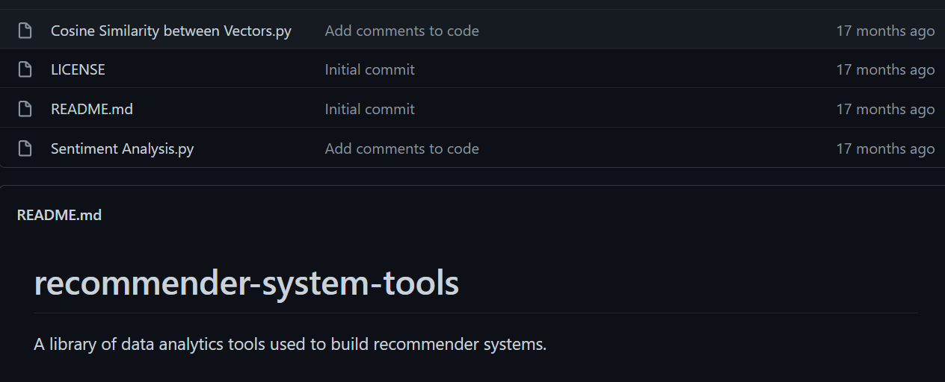
Literature Review
D. Tell Me What You Want: A Recommender System Based on Customer Preferences and Product Reviews
Authors : Josh Barua

Slide 11

02
CEP and Mapping

Slide 12
MAPING AMONG Ps, COs, POs
Complex Engineering Mapping
How Ps are addressed through the project:​
Ps | Attribute | Ps are addressed through the project | CO | PO
P1 | Depth of Knowledge Requirement | Our project requires Machine learning(K2), rigorous study of existing projects(K8), survey & reviews from users, monitoring new products(K3,K4), knowledge of web-development(K6), data collection & analysis(K5). | CO1 CO2 CO3 CO7 | PO1 PO2 PO3 PO5
P3 | Dept of Analysis Requirement | Users requirements, device feather's data, users demand etc. | CO4 CO7 | PO2 P12
P4 | Familiarity of Issues | We need to Analyse & implement various programming knowledge and skills to fix many issues | CO7 | PO3 PO9
P7 | Interdependence | Our project involves interdependent components such as requirement analysis, designing, back-end, front-end, software testing, dataset etc. | CO2 CO7 | PO2 PO10

Slide 13
How As are addressed through the Project
Complex Engineering Mapping
Ps | Attribute | Ps are addressed through the project
A1 | Range of Resources | Device's data are collected. Web framework is important resources for this project. It engages diverse resources including various designing tools.
A2 | Level of Interaction | Successful interaction between Web framework and NLP
A5 | Familiarity | Our project deals with Internet users.

Slide 14
How As are addressed through the Project
Complex Engineering Mapping
CO | CO Statements | Corresponding POs
CO1 | Identifying a real-life problem that can be transmitted to an engineering or computing solution through design, development and validation. | PO4 PO10 PO12
CO2 | Identify, formulate and analyze a real world compels engineering problem based on requirement | PO2 PO3
CO3 | Design/Develop a working solution on a complex software-intensive system and verify and validate the solution using industrial state of the practice, that indicates a high-quality software-intensive system | PO1 PO5 PO11
CO4 | Use a modern/popular IDE to test complex software-intensive systems. | PO7
CO7 | Work as a team and fulfil individual responsibility | PO9

Slide 15
Program outcomes(PO) for engineering programs
Complex Engineering Mapping
NO | PO | Differentiating
1 | Engineering Knowledge | Breadth & depth of education and type of knowledge, both theoretical & practical.
2 | Problem Analysis | Complexity of analysis
3 | Design/development | Breadth and uniqueness of engineering problems.
4 | Investigation | Breadth and depth of investigation and experiment
5 | Modern Tool Usage | Level of understanding of the appropriateness of the tool
6 | The Engineering and Society | Level of knowledge and responsibility
7 | Environment & Sustainability | Type of solution

Slide 16
Program outcomes(PO) for engineering programs
Complex Engineering Mapping
NO | PO | Differentiating
8 | Ethics | Understanding and level of practice
9 | Individual and Team work | Role in and level of practice
10 | Communication | Level of communication according to type of activities performed
11 | Project Management and Finance | Level of management required for differing types of activity.
12 | Lifelong learning | Preparation for and depth of Continuing learning.

Slide 17

03
Requirement Analysis

Slide 18
Requirement Analysis
RAM
CPU, GPU
Storage
Weight
Ram size, specification
CPU brand, GPU preference
Storage of the laptop
Weight of the laptop

Slide 19
Time & Budget
Week | Description
1st | Discussion
2nd | Project Proposal
3rd | Design: UML, ER-Diagram, DFD, Gantt chart
4th | Project Update – 1
5th | Project Update – 2
6th | Project Update – 3
7th | Final Project

Slide 20
Functional Requirements
Software Requirements
Hardware Requirements
CPU- Ryzen 7 3750H
GPU- 8GB, RX470
SSD- 240gb
RAM- 16GB
Stable Internet Connection
VS Code
Pycharm
Jupyter Notebook
Discord
Github

Slide 21

Non-Functional Requirements
Accuracy
Effectiveness
24/7 active

Slide 22
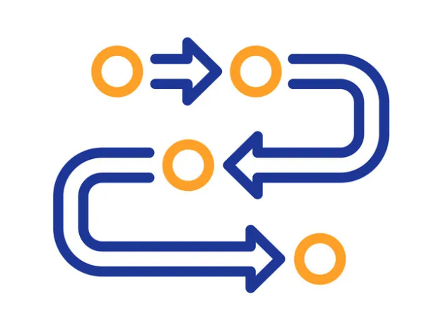
04
Methodology

Slide 23
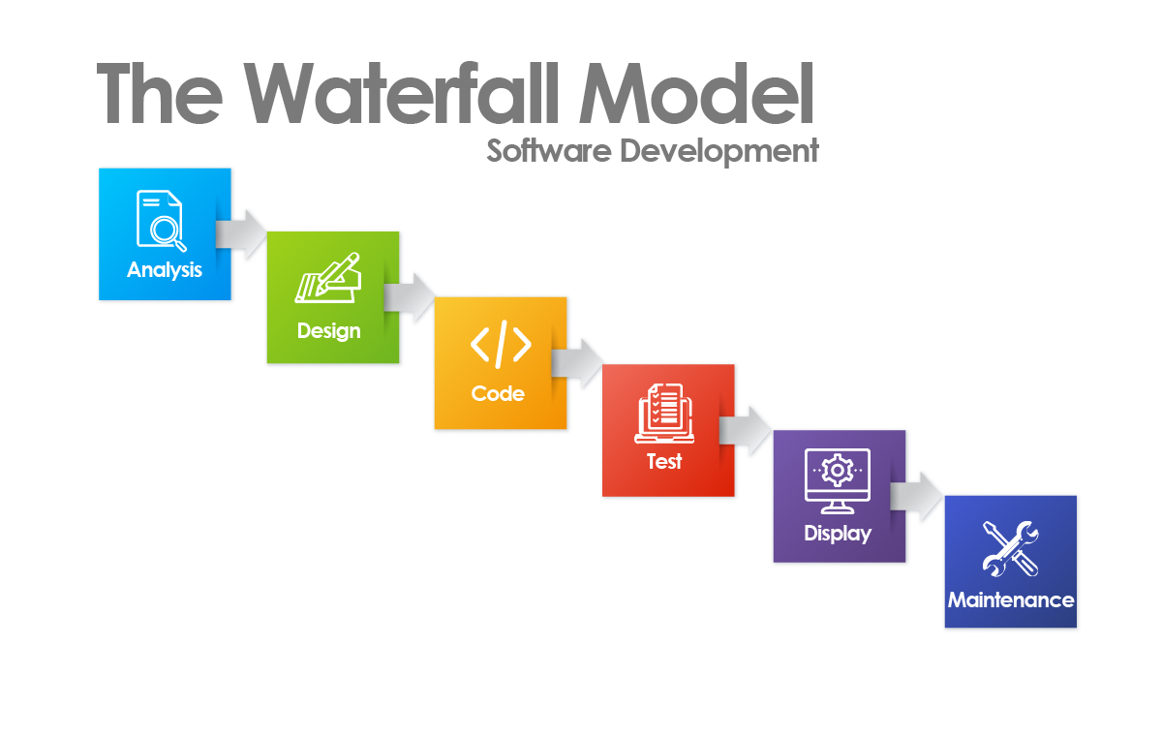
Methodology
Waterfall Model:
Referred to as a linear-sequential life cycle model
Oldest SDLC method
Earliest SDLC approach that was used for software development
6 Phase:
Analysis
System design
Implementation
Integration and Testing
Deployment of System
Maintenance

Slide 24
Thank you

